Slide 1
Bread and Pastry Production: Supplies and Materials
RONALD PAUL BRIONES JR.

Slide 2
INGREDIENTS IN BAKING
FLOUR
SUGAR
LEAVENING AGENTS
LIQUID INGREDIENTS
FATS AND OIL
EGGS
OTHER INGREDIENTS

Slide 3
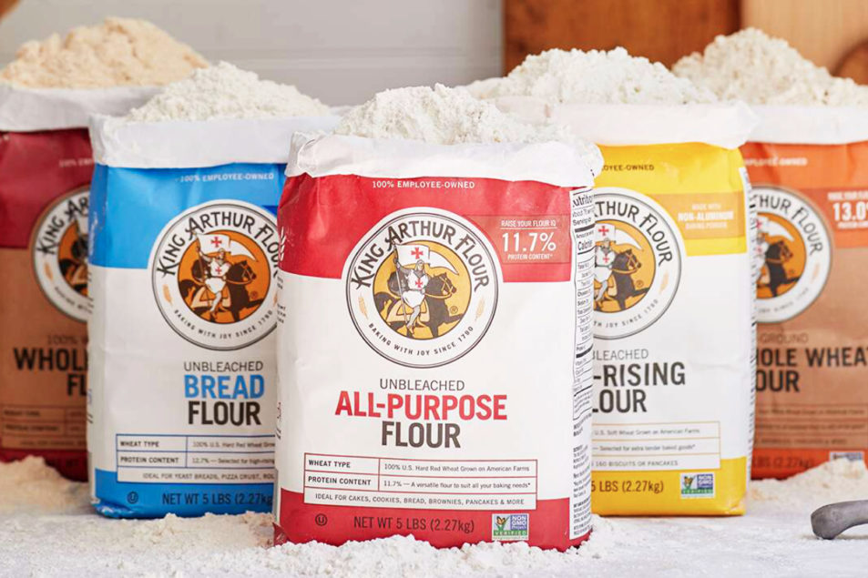
FLOUR
is the main ingredient among all other baking ingredients.

Slide 4
4 KINDS OF FLOUR
WHOLE- WHEAT FLOUR
BREAD FLOUR
CAKE FLOUR
ALL- PURPOSE FLOUR

Slide 5
WHOLE-WHEAT FLOUR
also called as graham or entire wheat flour that contains the compact of wheat kernel in its original proportion

Slide 6
BREAD FLOUR
also known as strong and hard flour which is ideal for making breads, rolls, and other sweet yeast- raised product.

Slide 7
CAKE FLOUR
also know as soft flour which is ideal for cakes, cookies, pastries, and rye.

Slide 8
ALL- PURPOSE FLOUR
Also known as general flour or pastry flour which is used as a substitute for making breads, cakes, and pastries.

Slide 9
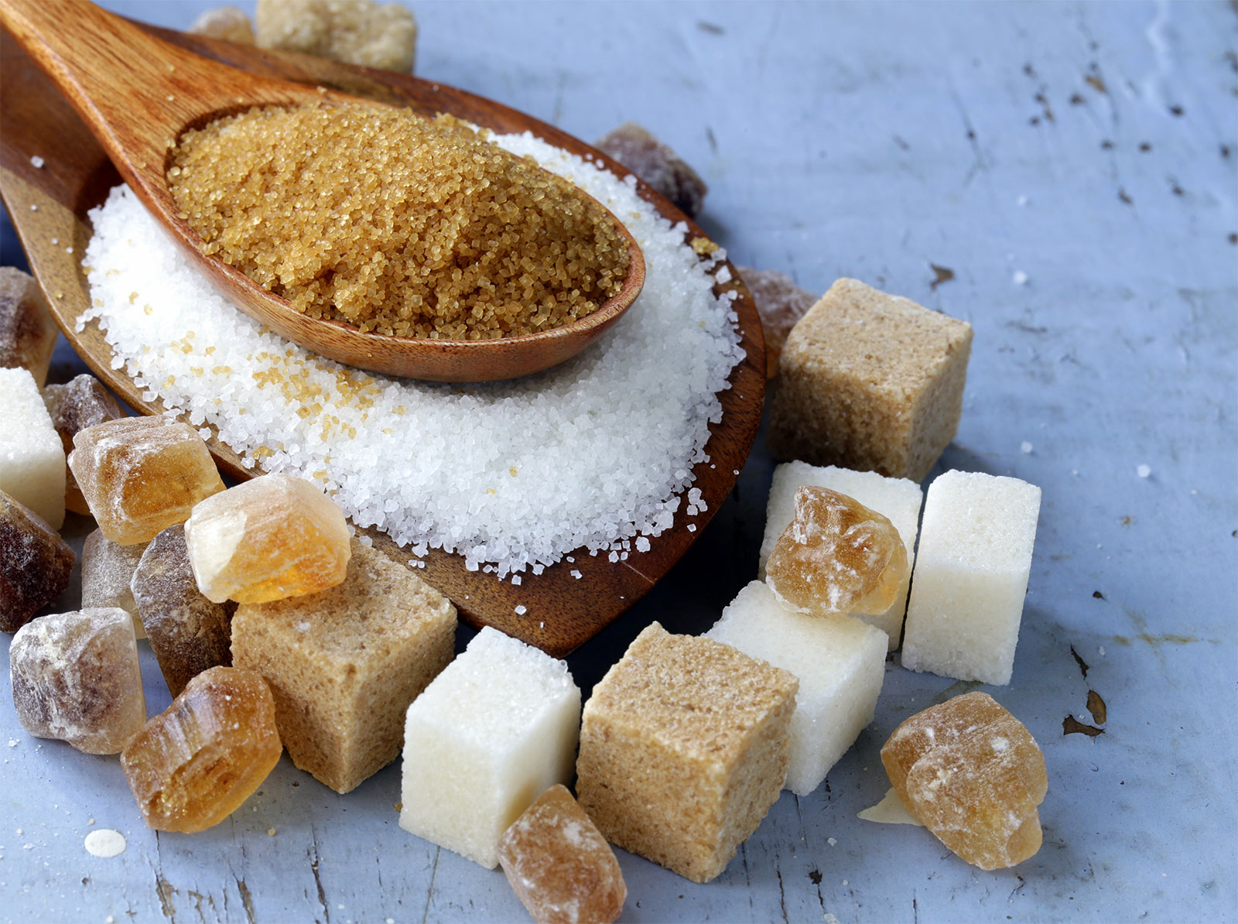
SUGAR
a sweet, crystalline, and soluble compound that comes from processing of sugar cane and sugar beets.

Slide 10
DIFFERENT FORMS OF SUGAR
BROWN SUGAR
WHITE, GRANULATED SUGAR
CONFECTIONER’S SUGAR

Slide 11
BROWN SUGAR
This sugar comes from different shades of brown depending on how well it has been processed. Brown sugar is less purified than white sugar.

Slide 12
WHITE, GRANULATED SUGAR
This is the type of sugar commonly used by bakers in practically all baked products and in preparing varieties of icings and fillings.

Slide 13
CONFECTIONER’S SUGAR
This sugar is the finest in texture compared with brown or white sugar.

Slide 14
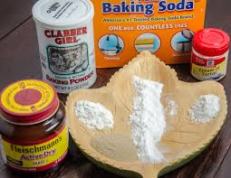
LEAVENING AGENTS
are the substances that produce gas while mixing or heating the dough or the batter.

Slide 15
EXAMPLES OF CHEMICAL LEAVENER
YEAST
BAKING POWDER
BAKING SODA

Slide 16
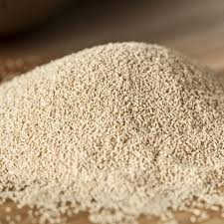
YEAST
is a microscopic unicellular plant cell which is available in the market in dry and granular form and as cake or compressed yeast.

Slide 17
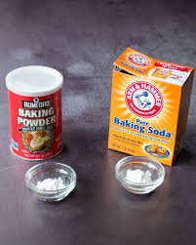
BAKING POWDER
is a chemical leavening agent that is produced by mixing baking soda and acid salt.

Slide 18
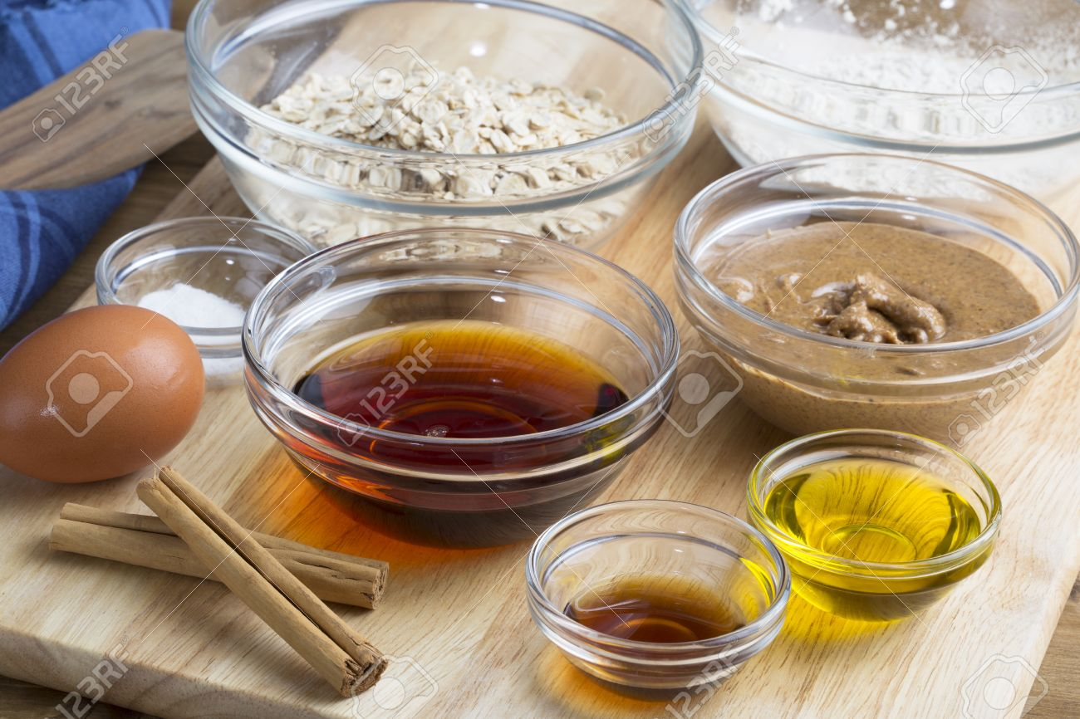
LIQUID INGREDIENTS
includes water, milk or cream, and fruit juices.

Slide 19
FATS AND OIL
BUTTER
BUTTER COMPOUND
MARGARINE
HYDROGENATED FAT
HOG FAT OR LARD
VEGETABLE OIL

Slide 20
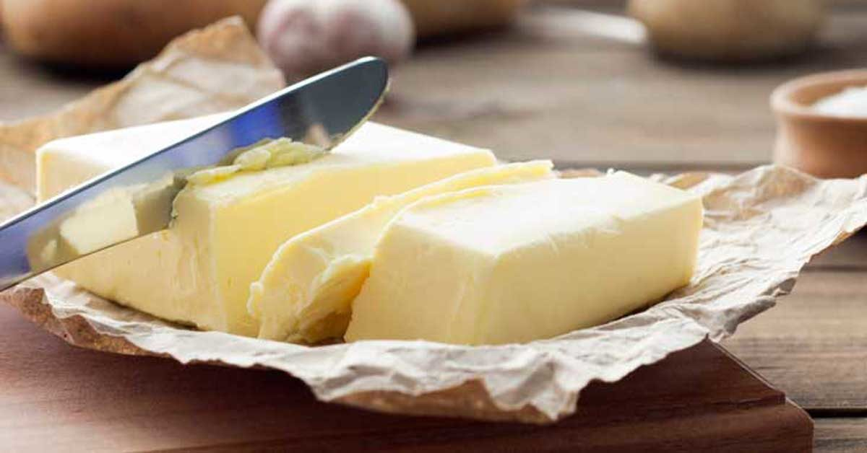
BUTTER
is ripened cream of milk and used in dough because it improves taste and flavor.

Slide 21
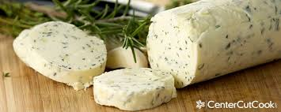
BUTTER COMPOUND
Is made by mixing 40% melted fat with from vegetable oil such as coconut oil, peanut oil, corn oil, cottonseed oil, etc. and it is less expensive than butter. These are used mostly in bread.

Slide 22
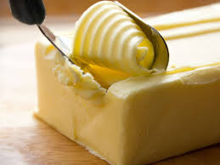
MARGARINE
This is fat emulsified with cultured milk and is widely used in bread, cakes and cookies.

Slide 23
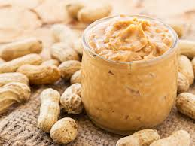
HYDROGENATED FATS
are commonly used in cakes , bread, pie crust, and pastries.

Slide 24
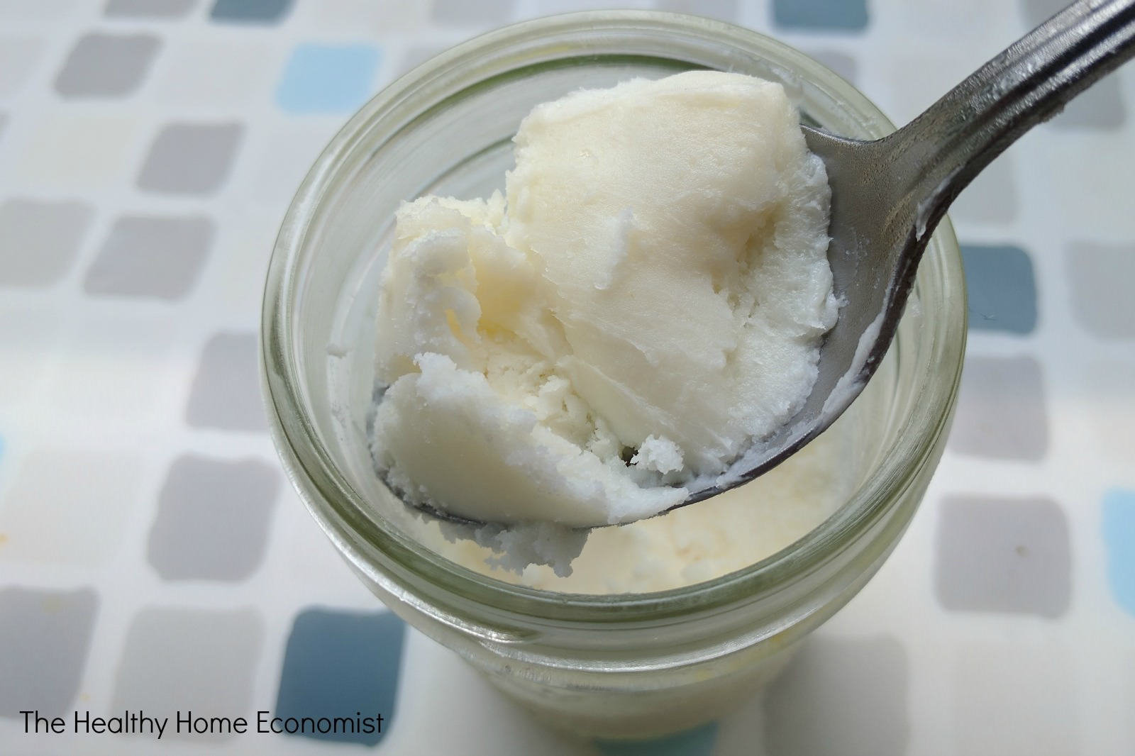
HOG FAT OR LARD
This comes from the back or sides of hog.

Slide 25
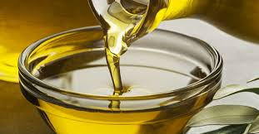
VEGETABLE OIL
This is liquid fat used in cakes and breads.

Slide 26
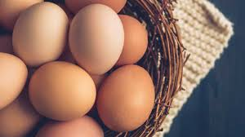
EGGS
Eggs contribute much to a baked product. It acts a leavener and its gives color, richness, flavors, and nutritive value to breads and pastries.

Slide 27
OTHER INGREDIENTS
SALT
SPICES OR SEEDS
FLAVORINGS

Slide 28
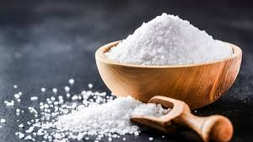
SALT
It is known as sodium chloride which is used to bring out the flavor of an otherwise bland, too sweet, or too sour taste.

Slide 29
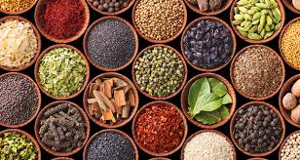
SPICES OR SEEDS
They are used in baking mainly due to the aroma and flavor they impart to the baked products.

Slide 30
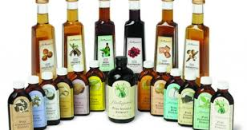
FLAVORINGS
Flavor extracts, whether synthetic or natural, are widely used in cakes, cookies, pastries, breads and spices.

Slide 31
QUIZ # 2.1 ESSAY
WHAT IS THE USE OF LEAVENING AGENTS IN DIFFERENT BAKED PRODUCTS?
WHY DO WE NEED TO USE DIFFERENT FLOURS FOR DIFFERENT BAKED PRODUCTS?

Slide 32
ACTIVITY # 2.2
SEARCH ANY BREAD AND PASTRY PRODUCTION: SUPPLIES AND MATERIALS FOUND IN YOUR PLACE AND SEND IT TO MY GMAIL.
IT MUST BE EDIT, LABEL EACH ITEMS AND PROVIDE THEIR FUNCTION.
Rpaul_jhsfac@uspf.edu.ph

